Slide 1
PROBLEM STATEMENT
Local politics can feel like an insiders’ conversation
Newcomers often disengage before they feel informed or welcome enough to participate.
Knowledge
NYC residents
I don’t know what’s happening or how to get involved
Awareness & belonging
StoopReport
Belonging
Interest & confidence
Make civic information
welcoming and accessible so that people can actually move down the funnel and become active members of their community
This conversation isn’t for me
Participation
Confidence
Ongoing engagement
I don’t know enough to contribute
41.6%
of registered voters participated in NYC’s 2025 general election,
despite the highest city-election turnout in over 50 years.
Source: NYC Votes, 2025 Voter Analysis Report. Turnout provides context; it does not establish causes of disengagement.

Slide 2
Pitch
People who moved to the city often end up disengaged as local politics can feel like an insider’s conversation.
The Stoop Report is a comedy content program on social media platforms people already are using (YouTube, TikTok, Instagram) that aims to help people stay up to date with local politics in a fun and low-stakes way.
By using comedy, we lower the barrier for engagement and invite them in to the conversation by making local politics feel more welcoming and accessible. Ultimately, knowing what’s happening is the first foundational step toward getting involved and having a voice in your community.

Slide 3
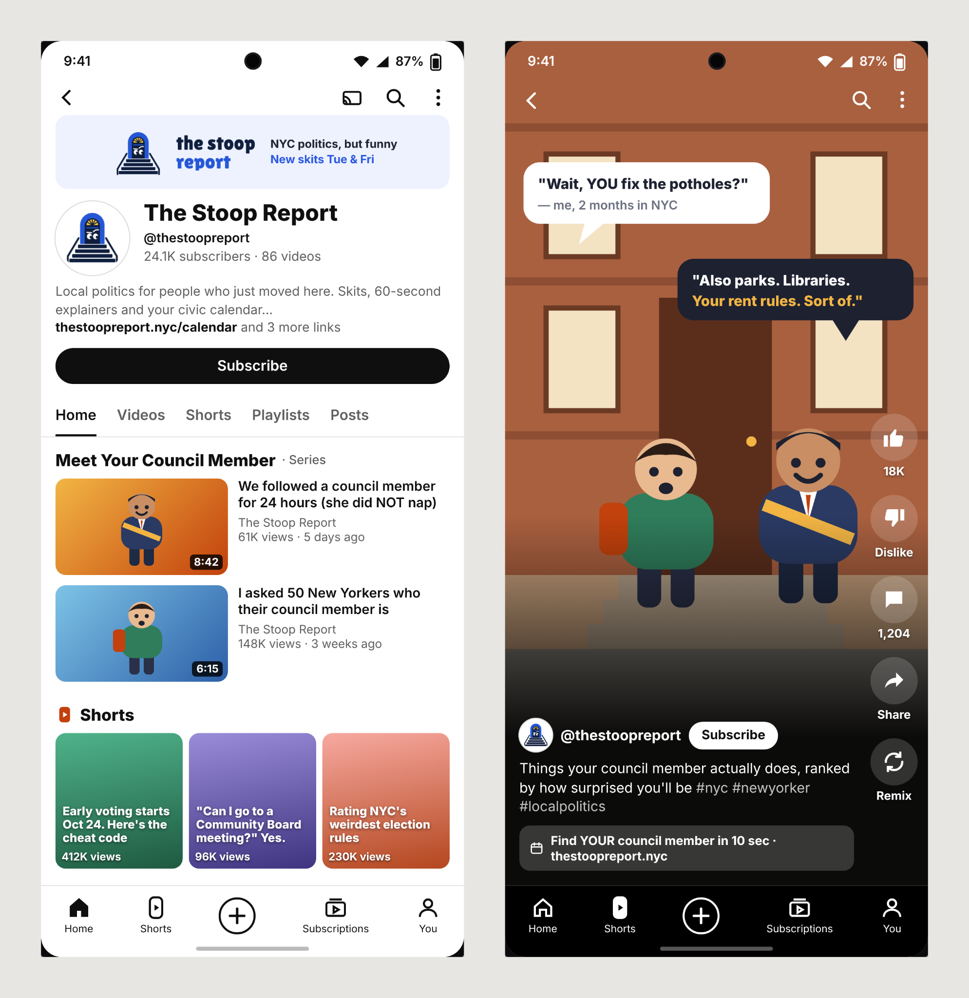
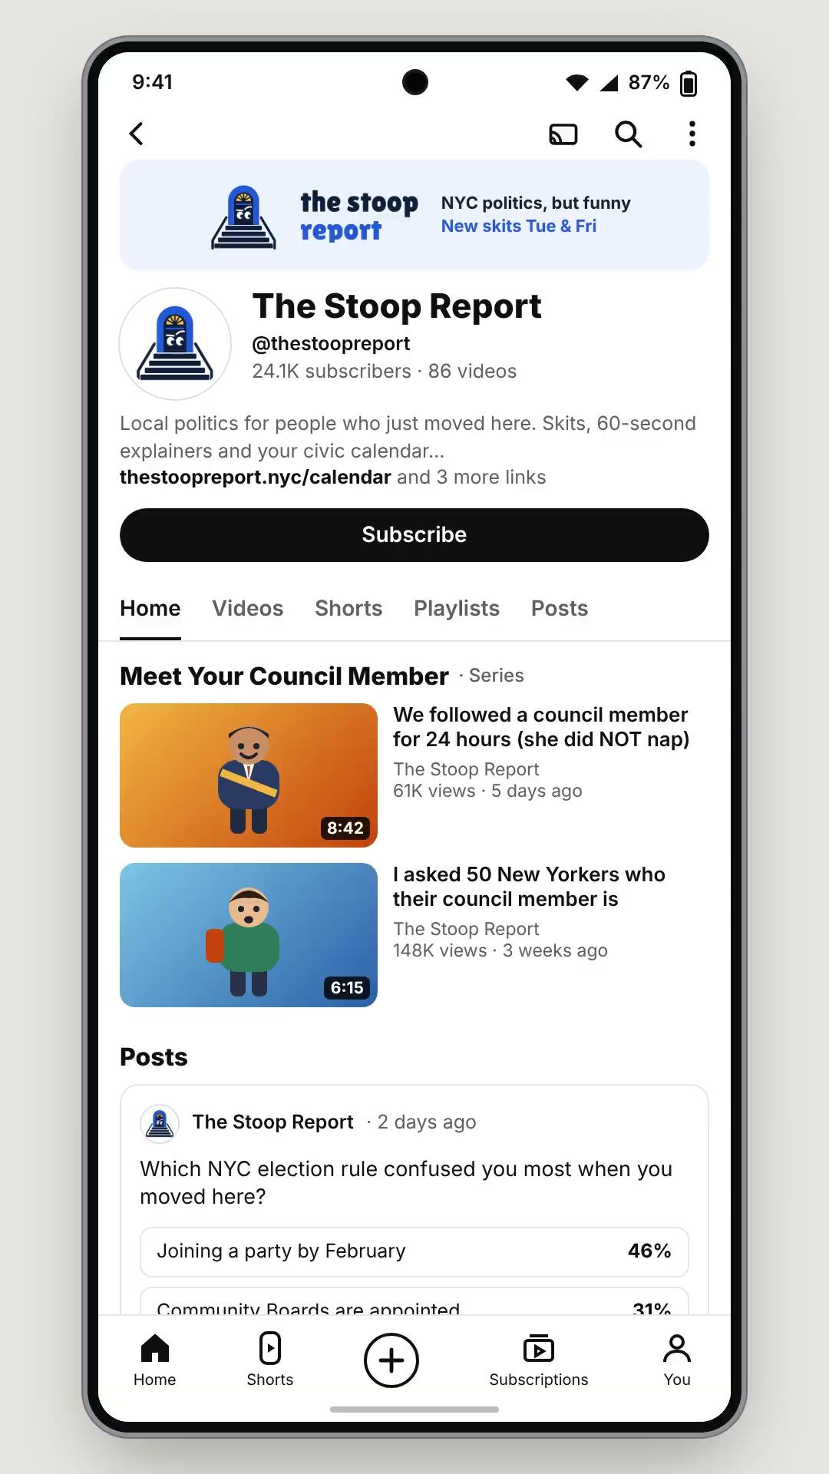
Prototype
The Stoop Report - a local civic news comedy channel to update citizens on what is happening and how to get involved
Screenshots of Channel
Shorts/Reel Video
Strengths
Ease of access on known social media platform lowers the bar in finding neighborhood politics
Comedy & skits brings younger audiences into the loop
Weaknesses
Relies highly on the social media managers

